Slide 1
Flatten the family violence curve

Slide 2
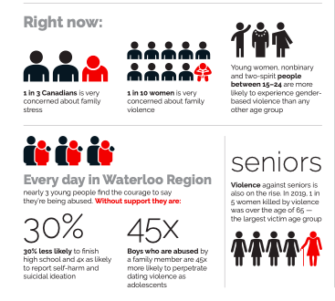
The issue
Globally, research linking pandemics to family violence is very clear
Research also shows that simple, early intervention – social cohesion - can help defuse tense situations before they escalate
Notes:
Source: Statistics Canada, April 2020 https://www150.statcan.gc.ca/n1/daily-quotidien/200408/dq200408c-eng.htm

Slide 3
The need
People at-risk need to know help is available
Neighbours, friends, family and co-workers need to know the signs, what to say and how to help
At home
At work
In the community
Everyone needs to know that small, easy caring gestures can help

Slide 4
You can Help #keep families safe
Visit www.preventingcrime.ca/keepfamiliessafe to learn how to help at home, at work and in the community.
Know and share the sign https://youtu.be/AFLZEQFIm7k
Reach out to anyone who is isolated or who may need support
Share this information in your workplace, with your teams, clubs, faith community and social circles
Share on social, on your website or any communication channels you have
Record a video supporting the campaign (ask us how!)
Join a virtual porch chat

Slide 5
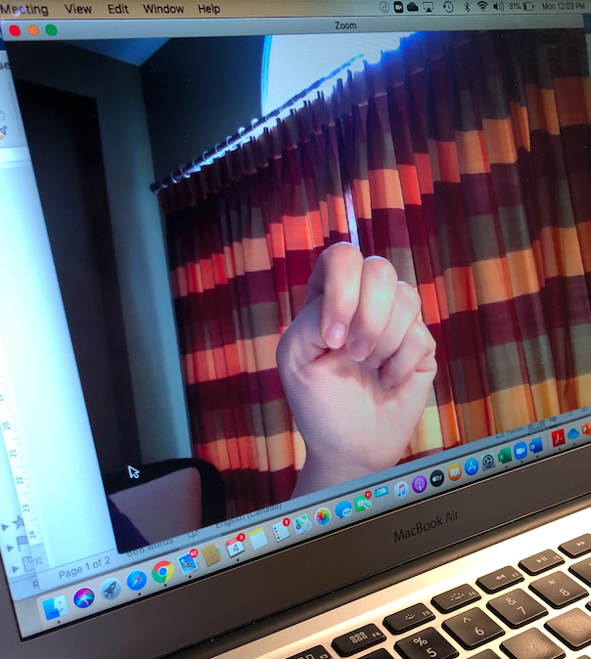
Know the signs
Isolation Financial control Fear
Humiliation Ridicule Blame
Name-calling Put-downs Injuries
Destruction of property or harming pets
Physical or emotional abuse
Nervousness
Neglect in the case of children
On video, if someone curls four fingers over their thumb and raises it with their palm towards the camera, it’s a call for help.
https://youtu.be/AFLZEQFIm7k

Slide 6
Know how to help
ASK: Do you feel safe? How can I help?
ACT:
Stay connected to break isolation
Offer information about community supports
Offer personal support
If danger is imminent and you need immediate help, contact
Women’s Crisis Services of Waterloo Region at (519)742-5894 in Kitchener-Waterloo
Local police at 9-1-1 in an emergency
Family and Children’s Services (FCS) at 519-576-0540

Slide 7
Share Support material
Print and virtual postcard
Infographic
Website
Web sliders and content
Social media drafts and video scripts
Porch chats and custom training sessions
Presentations

Slide 8
Join our growing coalition
Notes:
Double checking: brought to you by and on website

Slide 9
contact
Julie Thompson
Waterloo region crime prevention council
Jthompson@regionofwaterloo
Tel: (519) 635-1412

