Slide 1
Flatten the family violence curve
Notes:
We know that with the Global Pandemic, family violence tends to increase

Slide 2
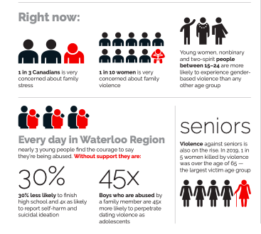
The issue
Globally, research linking pandemics to family violence is very clear
Research also shows that simple, early intervention – social cohesion - can help defuse tense situations before they escalate
Notes:
Already in your workplace, 24% of people may have experienced family violence.
In addition
In this pandemic: 1 in 3 Canadians are very concerned about family stress, and 1 in 10 women are very or extremely concerned about family violence.

Slide 3
OHSA – Bill 168 Domestic Violence
Bill 168 requires employers to “take every precaution reasonable to the circumstances” to protect workers from domestic violence that would likely cause physical injury to workers in the workplace.
This obligation arises only if the employer is aware, or ought reasonably to be aware, of the situation.
Notes:
The statistics in Waterloo Region are very concerning and you as an employer under the Occupational Health and Safety Act, or Bill 168, have a responsibility to ensure that all employees have a safe and healthy workplace, including protecting employees from the risk of domestic violence in the workplace. As coworkers you have a responsibility to one another to identify the signs of family violence, and to intervene in an appropriate way. And, of course, everyone, including members of the public, is also required by law to report suspected cases of child abuse or neglect.

Slide 4
The need
People at-risk need to know help is available
Neighbours, friends, family and co-workers need to know the signs, what to say and how to help
At home
At work
In the community
Everyone needs to know that small, easy caring gestures can help prevent or ease tension that can lead to violence
Notes:
So would you know how to do that today? As more and more people continue to work remotely, are you able to identify the signs of domestic violence?
Those at risk of family violence need to be aware that they can access services and that they are safe.
Managers, supervisors, co-workers, family, friends and neighbours all need to know the signs and how to help at work and at home and in the community.
Everyone needs to know that small, easy caring gestures can help to ease the tensions that can lead to violence.
Because even the smallest gesture can be really significant.

Slide 5
You can Help #keepfamiliessafe
Visit www.preventingcrime.ca/keepfamiliessafe
Know and share the sign for help on video calls https://youtu.be/AFLZEQFIm7k
Reach out to anyone who is isolated or who may need support
Share this information in your workplace, with your teams, clubs, faith community and social circles
Join a virtual porch chat
Notes:
To address the important issue in Waterloo Region, a broad coalition of agencies and municipalities launched the #KeepFamiliesSafe campaign.
Here are 5 easy ways YOU can help:
Visit preventingcrime.ca/keepfamiliessafe for tips on how to help prevent family violence at home, at work and in the community.
Because so many people are working remotely and participating in video calls, it’s important to know and share this sign. [Do the sign slowly] If someone makes this motion “ “ towards the camera during a video call, you will know this is a sign for HELP. Please share this with your teams the next time you have a video conference and remind them periodically. Why not share it in your social and professional networks too?
3. Reach out to anyone who’s isolated or who might need support. Maybe there’s someone on your team where family stress is escalating due to job loss or uncertainty. We know that when stress is high it’s more difficult to cope. Can you connect them to the appropriate services in the community to help alleviate that stress or encourage them to contact an Employee Assistance Program if one is available in your workplace? Caring enough to reach out and to connect them to existing supports can make a difference.
4. We need to talk about what the United Nations has called the “shadow” pandemic. So please, talk about the rise in family violence and the resources available during a team meeting and
share the #KeepFamiliesSafe information in your corporate, professional and personal communication channels. You can even record a video supporting the campaign – just use Hashtag #KeepFamiliesSafe
5. You could also join a virtual porch chat for more in-depth learning, but in a casual environment.

Slide 6
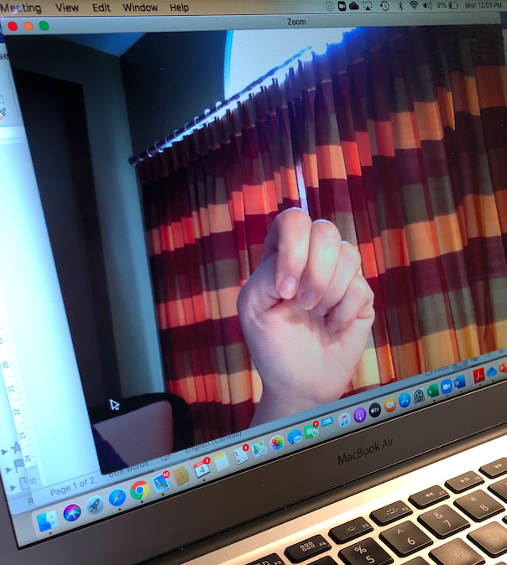
Know the signs
Isolation Financial control Fear
Humiliation Ridicule Blame
Name-calling Put-downs Injuries
Nervousness
Destruction of property or harming pets
Physical or emotional abuse
Neglect in the case of children
On video, if someone curls four fingers over their thumb and raises it with their palm towards the camera, it’s a call for help.
Notes:
Since it is our responsibility to know the signs of domestic violence and then to offer support, would you know the signs?
Do you have co-workers who seem isolated? If it’s a video call, do you hear language behind them that is humiliating? Do you hear put-downs or name calling?
Have people expressed that this person is subject to physical or emotional abuse? Does the person have frequent injuries or seem particularly nervous?
All of these, together in some combination can be signs.

Slide 7
Know how to help
ASK: Do you feel safe? How can I help?
ACT:
Stay connected to break isolation
Offer information about community supports
Offer personal support
If danger is imminent and you need immediate help, contact
Women’s Crisis Services of Waterloo Region at (519)742-5894
Local police at 9-1-1
Family and Children’s Services Waterloo Region (FACSWR) at 519-576-0540
Notes:
If you see these signs and you are concerned that a coworker or a member of your team is experiencing violence in their home, you can mention to them privately that you’ve noticed this
Ask: Do you feel safe at home? How can I help?
You are not a counsellor or therapist but you CAN offer to help connect them to the appropriate services.
If they refuse your help that’s ok, some people need to be asked more than once. Now they know that -if they need it- help is available.
You can stay connected to people to make sure that they are not feeling isolated.
You can offer information about community supports, You can also offer personal support.
If danger is imminent and you need immediate help, contact Women’s Crisis Services of Waterloo Region and they can walk you through what you need to do. You can call Police in an emergency and you can call Family and Children’s Services should you suspect that a child is at risk of abuse or neglect.

Slide 8
Learn more
July 29: Understanding emotional abuse and precursors to violence in the home
August 19: Resolving Family Conflict
Sept 24: Become an Active Bystander
www.preventingcrime.ca to register
Notes:
If you would like to learn more. We have a series of “Porch Chats” coming up. You’re welcome to register or we’d be happy to customize one for your organization if this is of interest

Slide 9
Share Support material
Print and virtual postcard
Infographic
Website
Web sliders and content
Social media drafts and video scripts
Porch chats and custom training sessions
Presentations
Notes:
The #KeepFamiliesSafe coalition has a number of support materials that could be helpful in your organization, so please reach out to us.
We’d be happy to help you raise awareness.

Slide 10
Join our growing coalition
Notes:
Finally, you can also join our growing coalition.
We’re counting on employers in the Waterloo Region to be aware of the rise in family violence and to support employees who may be at risk.

Slide 11
contact
Julie Thompson, Community engagement
Waterloo region crime prevention council
Jthompson@regionofwaterloo.cA
Tel: (519) 635-1412
Notes:
For more information, please contact Julie Thompson, Community Engagement at the Waterloo Region Crime Prevention Council.
Thank you for listening
Thank you for helping #KeepFamiliesSafe

